Slide 1
Essay Structure
This guide applies to essays longer then approximately 2500 words should follow the following formal structure:
Cover Page
(Abstract)
Introduction
Definitions
Chapters
Conclusion
Bibliography

Slide 2

Cover Page:
To include: Title, word count, student name & number, topic name, & instructor name. Note that word count does not include title, intext citations, or bibliography.
Introduction:
Introduce the main argument: ie, Identify the problematic, and how you intend to answer it. Briefly describe each chapter and explain how each one addresses and contributed to the overall argument. Note: The introduction should be the last part of the essay to be written.
Definitions:
Define (using authorative primary sources) any key terms that are required. Note that not all essays require definitions, especially where terminology is well-known.
Chapter Arguments:
Break your overall argument into themes or topics within a separate chapter. Each Chapter is structured like a mini-essay and should start with a very brief introduction, followed by the central argument, relevant counterarguments, and finish with a brief conclusion. Link the current chapter to each following chapter with a lead-in sentence of two. Ensure that all facts, statements, etc, are well-referenced using in-text referencing.
Conclusion:
Summaries each chapter, then draw the salient parts together into an overall conclusion that definitively addresses the problematic.
Bibliography:
Use MLA or Harvard format. Must be ordered alphabetically.

Slide 3
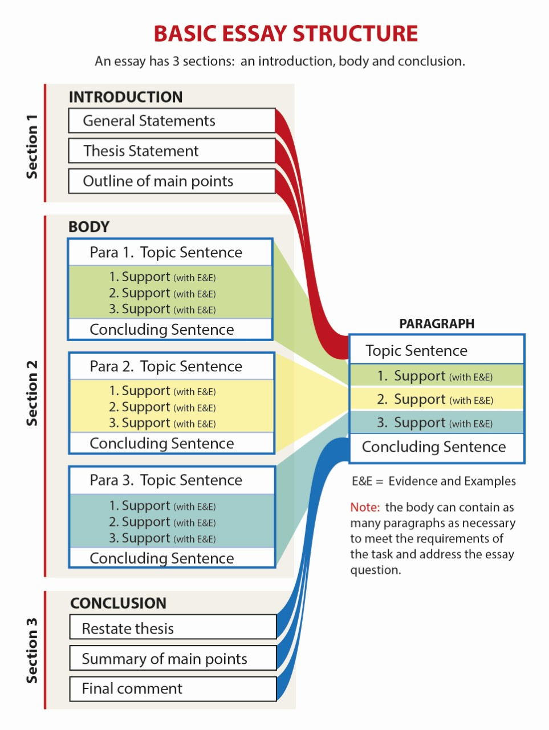

Slide 4
Note:
Academic writing is not like typical journalistic writing. Paragraphs tend to be lengthy, of at minimum 6 sentences. Try not to use elaborate “flowery” language.
Word counts are designed so that students can address the problematic with the desired depth of complexity. Failing to make the minimum word count indicates a lack of complexity and substance, while exceeding the word count indicates an inability to edit.
An abstract should be included for essays of over 10,000 words.
Abstracts, introductions, and conclusion word count should all be scaled in proportion with the essay word count.

